Slide 1
DSC3013 Intro. to Social
Media Analytics (Lec. 9)
Hao PENG
Department of Data Science
City University of Hong Kong
https://haoopeng.github.io/

Slide 2
Topics for this week
Applications of SNA
  Community detection
  Information diffusion
    Simple vs. complex contagion
    Linear threshold model (ABM)
    Global cascade
  Cascade prediction
    Content features
    Network features
    Temporal features
  Tutorial: Link Prediction

Slide 3
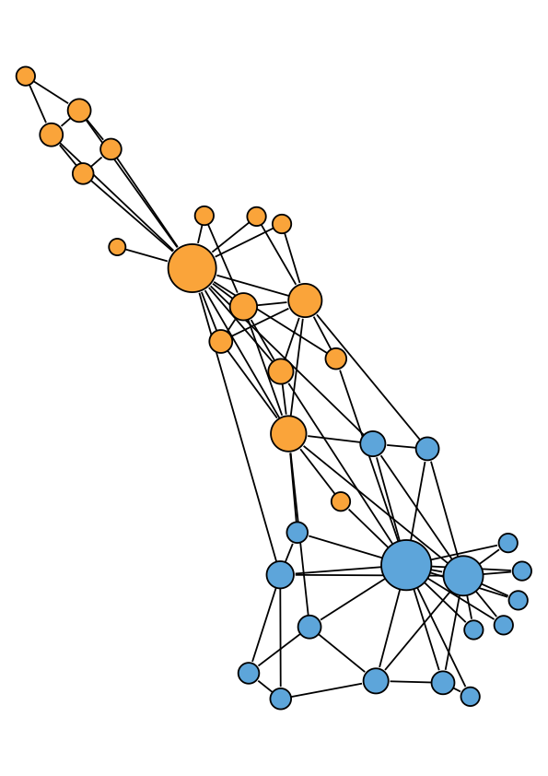
Community structure
Network communities are groups of nodes in a network with lots of connections within the groups and not too many between groups.
Friendship network in a karate club (Zachary 1977)
Notes:
Combine nodes and links

Slide 4
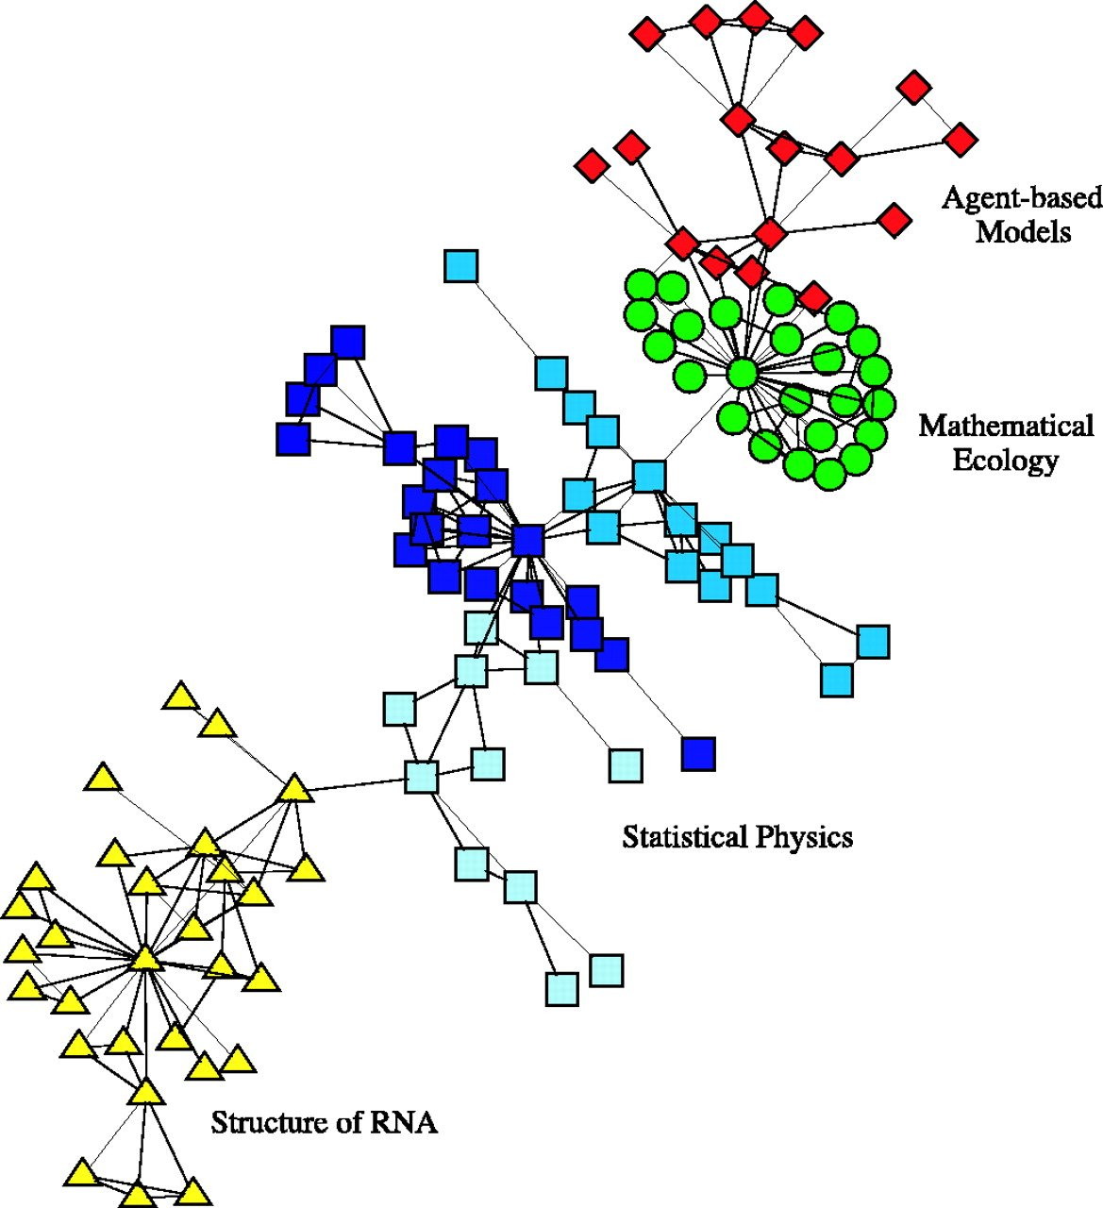
Scientific collaboration networks
Largest component of collaboration network at the Santa Fe Institute.
Mark Newman, PNAS, 2004
Notes:
Co-authorship network

Slide 5
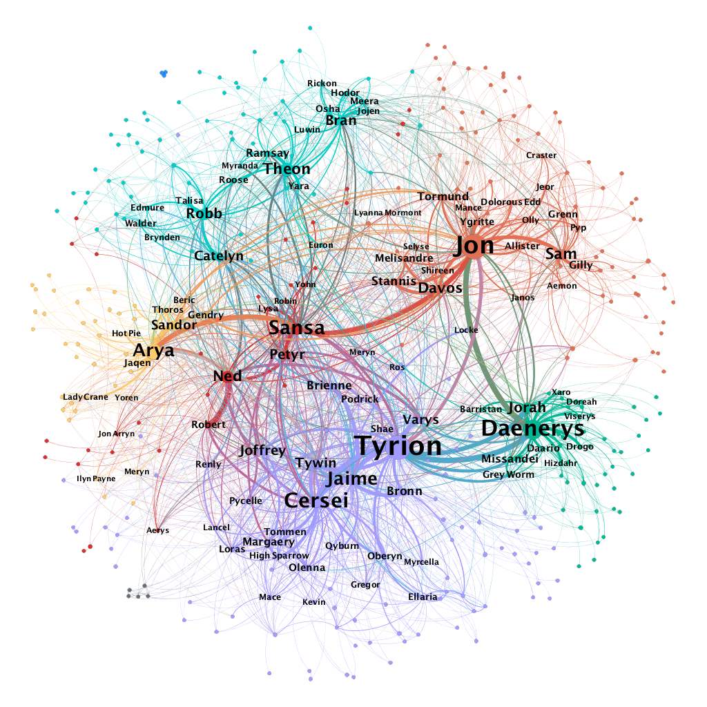
Networks in Game of Thrones
How could we know about the strength of community structure?
Does the observed structure exist due to random chance?
https://medium.com/web-mining-is688-spring-2021/web-of-thrones-255139b930bb
Notes:
Two actors show up in the same scene

Slide 6
Community detection
Network communities are groups of nodes in a network with lots of connections within groups and not too many between groups.
Algorithms for identifying communities:
1. Deploying a hierarchical clustering idea:
    Agglomerative (bottom up: successive pairing nodes by adding edges)
    Divisive (top down: successive splitting clusters by removing edges)
    2. Based on information theory (using random walks)

Slide 7
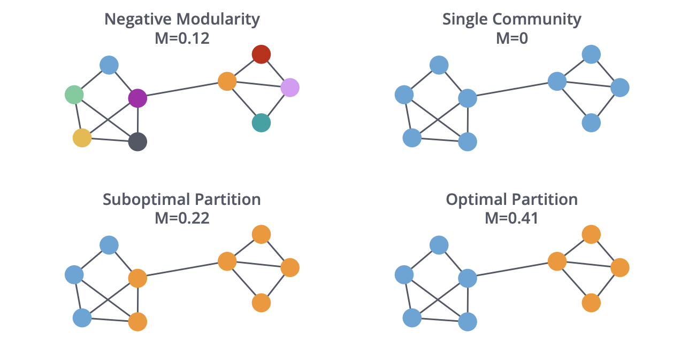
Hierarchical clustering approach
Start from each node as a community:
Start from all nodes in a single community:
Agglomerative clustering
Divisive clustering
Maël Fabien

Slide 8
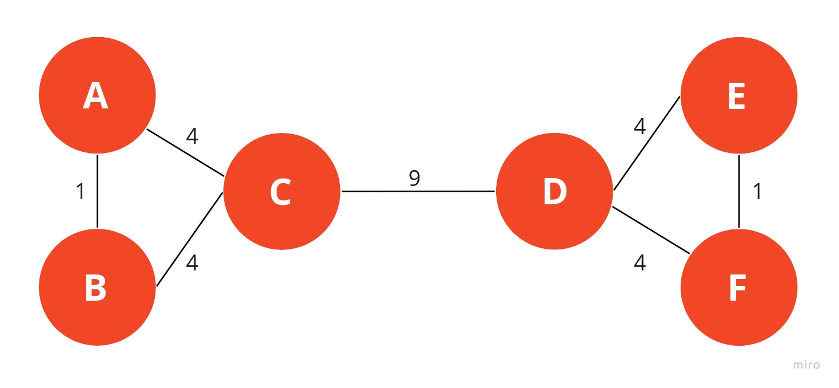
The Newman-Girvan algorithm
Repeatedly removing edges (divisive):
Calculate betweenness centrality score for all edges in the network.
Remove the edge with the highest betweenness centrality.
Recalculate betweenness for all remaining edges.
Repeat steps 2-4 until there are no more edges left.
Mark Newman, PNAS, 2006; Girvan and Newman, PNAS, 2002
https://memgraph.github.io/networkx-guide/algorithms/community-detection/girvan-newman/
Notes:
In practice, we can build a dendrogram to illustrate the merging process and determine the optimal cut.

Slide 9
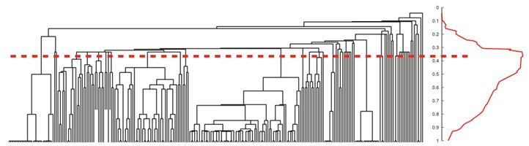
The Newman-Girvan algorithm
Repeatedly remove edges based on betweenness centrality.
It produces a dendrogram for different depth of network partition.
Can use modularity to measure the strength of community structure.
Mark Newman, PNAS, 2006; Girvan and Newman, PNAS, 2002
Notes:
In practice, we can build a dendrogram to illustrate the merging process and determine the optimal cut.

Slide 10
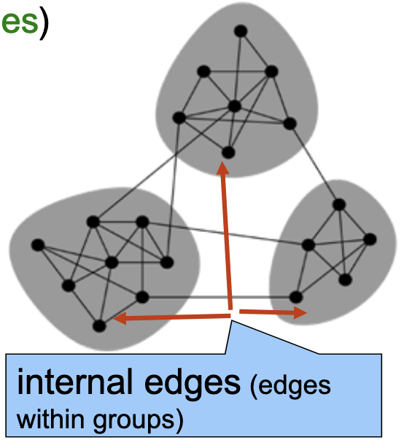
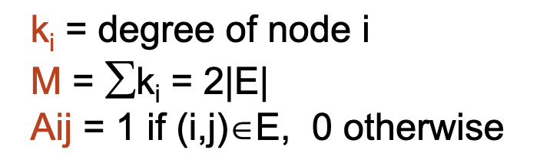
Network modularity (Q)
Modularity Q is the fraction of all edges that fall within the same groups minus the expected fraction if edges were distributed at random.
/M
Mark Newman, “Modularity and community structure in networks”. PNAS, 2006
Notes:
(Aij - ki*kj/M): the actual number of edges between (i, j) minus the expected number of edges between them.
Calculate the term (Aij - ki*kj/M) for all (i, j) pairs that are in the same group.
Recall lecture 7.

Slide 11
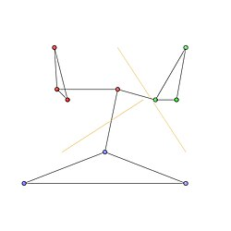
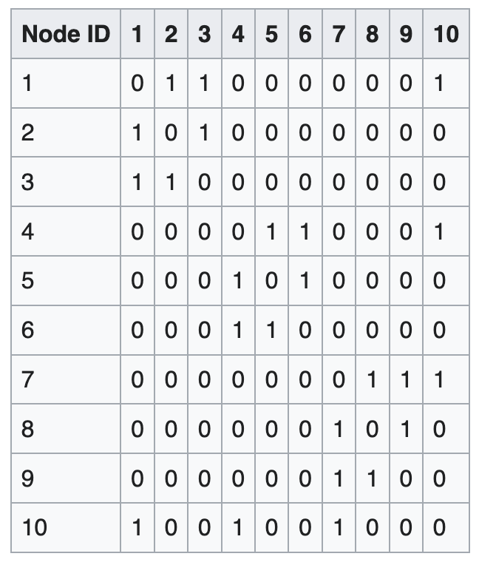
Adjacency matrix
C1
C2
C3
Partition that maximizes Q = 0.49
Notes:
Sample Network corresponding to the Adjacency matrix with 10 nodes, 12 edges.

Slide 12
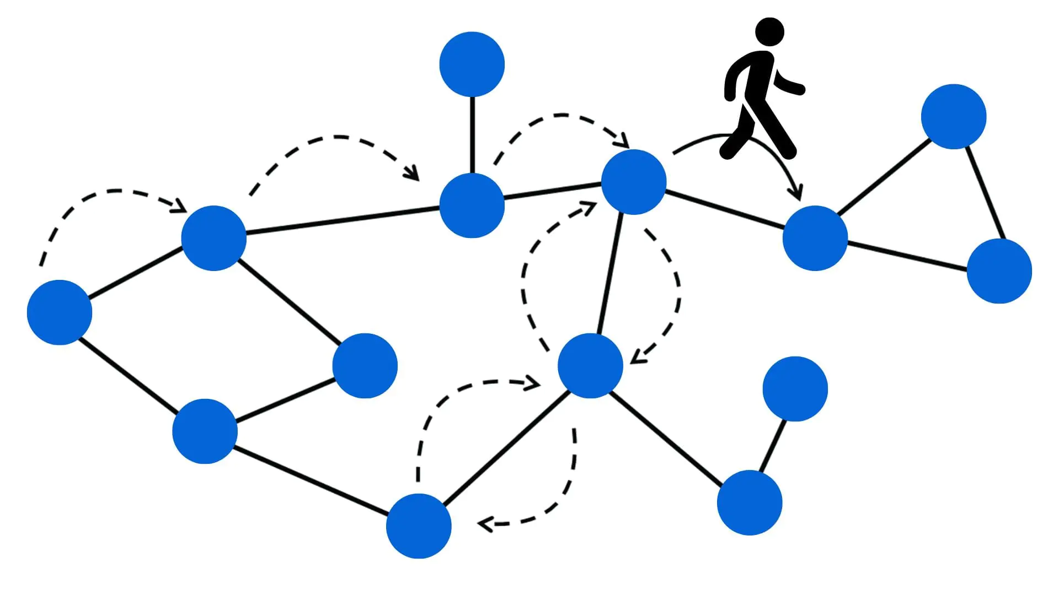
Node2vec algorithm
Generate random walks on a network (e.g., 100 steps)
Trick: consider each user as a “word”; then apply word2vec to generated “sentences” -> obtain user vector!
Final step: do clustering (k-means) on user vectors.
https://snap.stanford.edu/node2vec/
Notes:
Disciplinary and interdisciplinary relationships

Slide 13
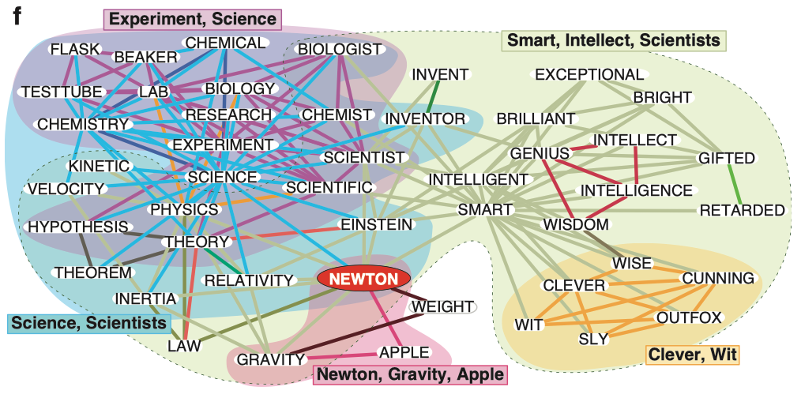
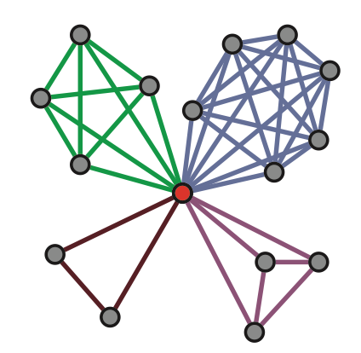
Perspective from Links
The node-level methods partition nodes into disjoint groups.
But a node can (often) belong to multiple communities.
Ahn et al. “Link communities reveal multi-scale complexity in networks.” Nature 2010.
Notes:
“Clever” could belong to the yellow cluster of positive adjectives, but it could also belong to the big cluster of words related to science or scientists.

Slide 14
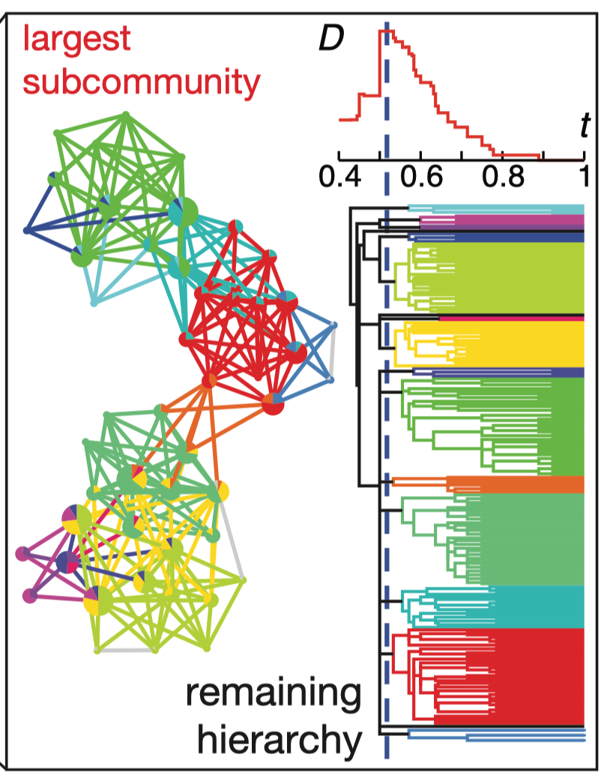
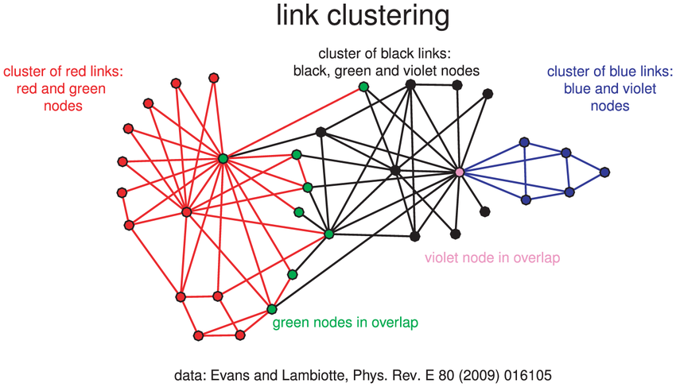
Community detection based on links
Clustering links for finding overlapping node communities
A node can belong to multiple identified link communities
Ahn et al. “Link communities reveal multi-scale complexity in networks.” Nature 2010.

Slide 15
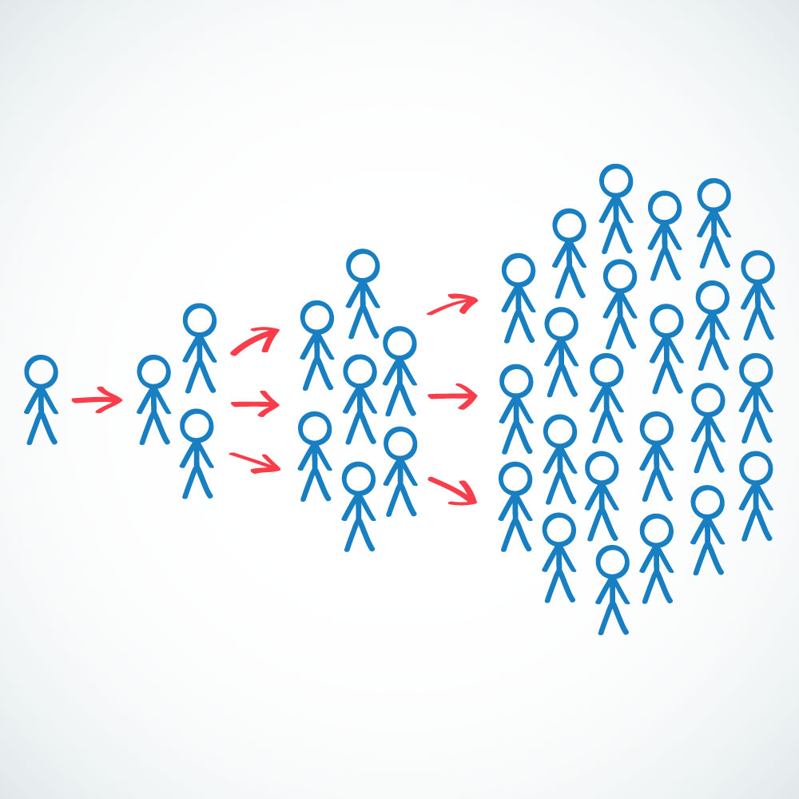
Viral marketing / information diffusion
Information diffusion refers to the process by which a piece of information, ideas, rumors, or innovations spread through a network ("chain reaction").
Being able to predict information spreading is vital for commercial marketing, tracking misinformation campaigns, and maximizing social influence.
Notes:
So far, we have talked about three measures, because knowing about their characteristics can …

Slide 16
Simple vs. complex contagion
Two common information diffusion models:
Independent cascade model (simple contagion)
  Information spreads like disease transmission
  A node has only one chance to “infect” its neighbors
  Each exposure is independent from each other
Examples?
Notes:
News and rumors – relying on weak tie is enough for sharing
How about joining a gym? Buy an IPhone? Accepting offer from CityU?

Slide 17
Simple vs. complex contagion
Two common information diffusion models:
Linear threshold model (complex contagion): Our focus!
  Exposure to multiple neighbors is needed for adoption
  Each node has a threshold for activation (count or fraction)
  More applicable to the spread of contentious behaviors
  More examples?
  (such as wearing mask, voting, jaywalking, new fashion)
Notes:
Social reinforcement theory

Slide 18
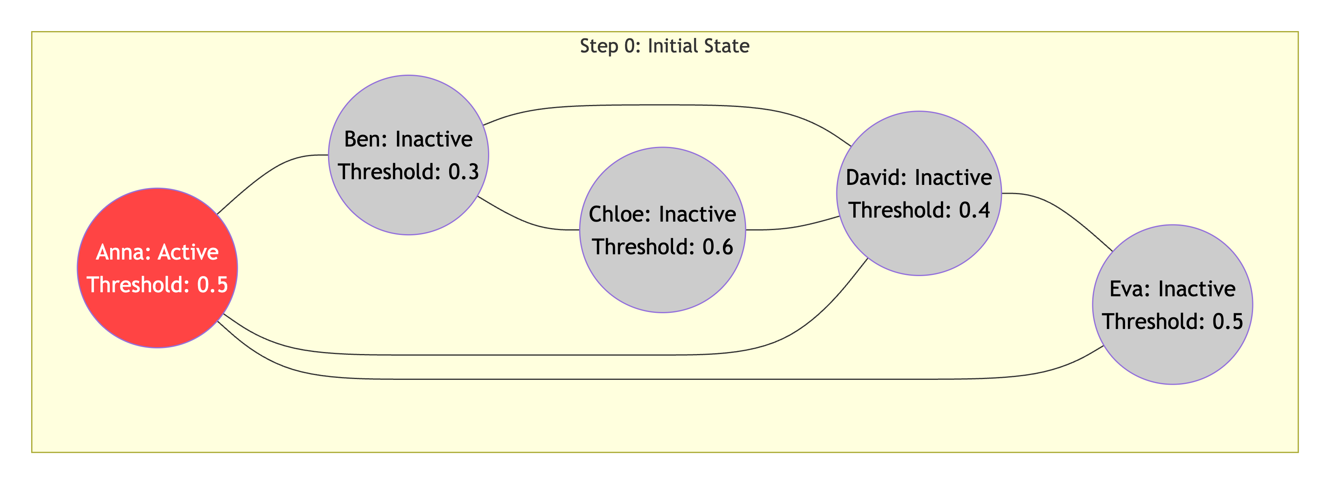
Agent-based modeling
Simulating complex contagion in discrete steps:
Start with a few seed nodes at step 0.
In each step, for each inactive node, check if the fraction of its active friends meets its threshold.
If so, activate the node (it remains active permanently later).
The process unfolds deterministically until no change happens.

Slide 19
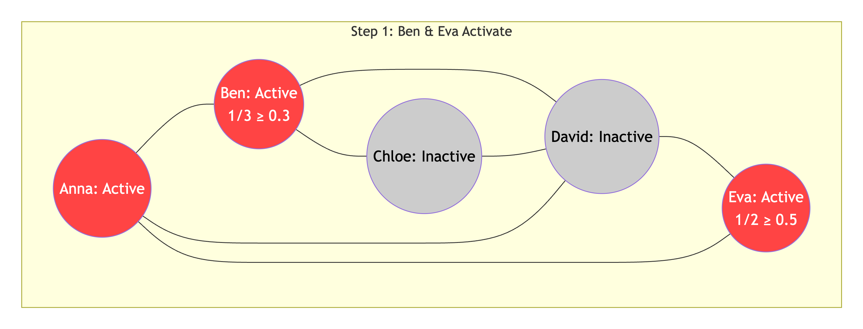
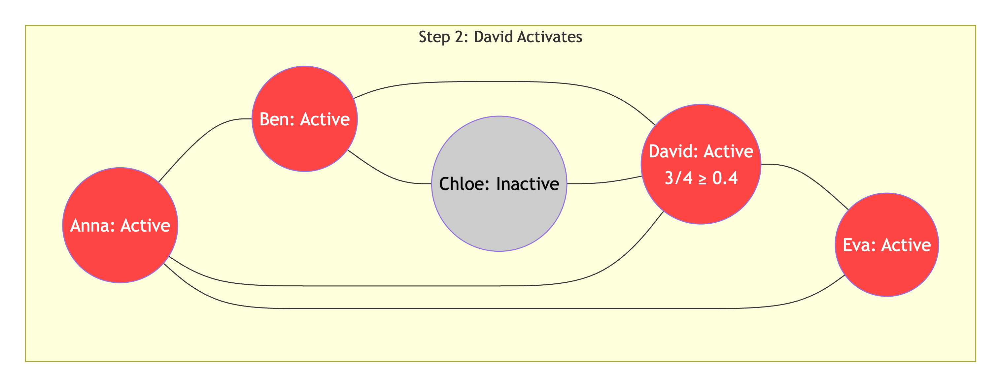
Complex contagion illustration

Slide 20
Global cascade
A global cascade means that:
(almost) every node gets infected in the end.
How can we “infect” the whole network with a limited budget?
How to select initial users? Pick influential users?
Are super-star users as important as we think?
What’s the impact of network structure?

Slide 21
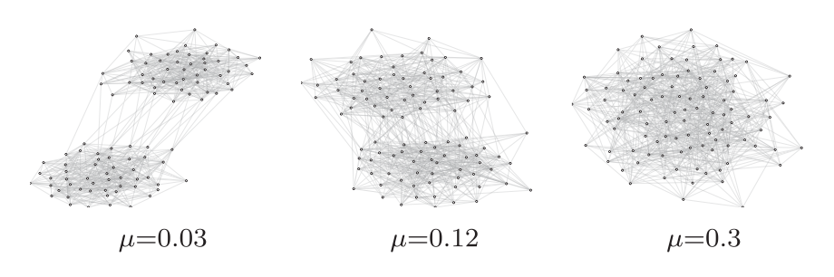
Community structure impacts cascade size more than seed nodes do!
A network with 2 equal-sized communities A and B;
Fixed network size: 100 nodes and 400 edges;
Each node has the same threshold 0.35;
Define u as the fraction of edges running between A and B;
Let u control strength of modularity (large u --> weak community);
Randomly activate 20% nodes (as seeds) in A;
Calculate final cascade size
A
B
Nematzadeh et al. “Optimal network modularity for information diffusion”. PRL, 2014.

Slide 22
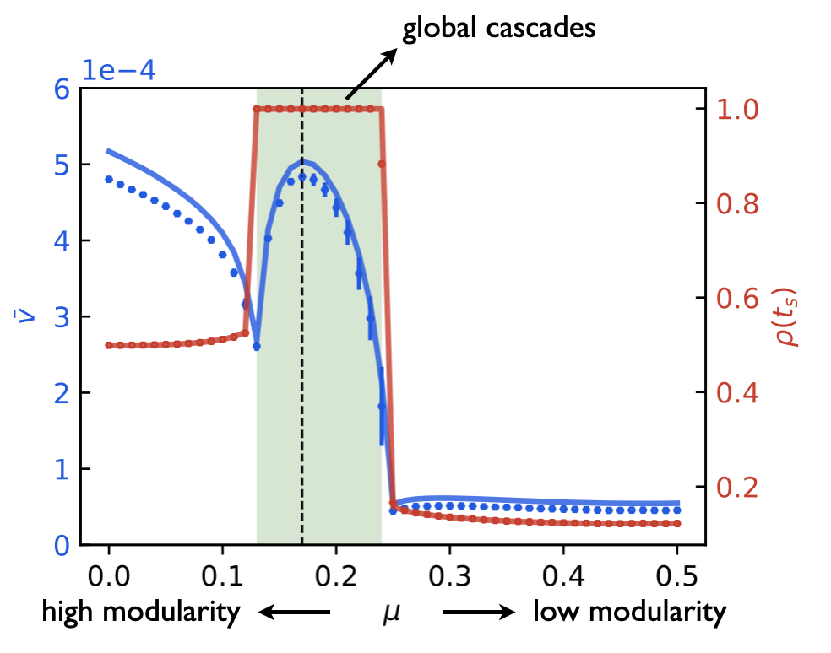
Optimal modularity for global cascade
Run 1000 simulations per u using Agent-Based Modeling.
Red plot (right y):
The cascade size
[Global cascade happens in the whole green area.]
Peng et al. “Network modularity controls the speed of information diffusion”. PRE, 2020.

Slide 23
Optimal modularity for global cascade
Blue plot (left y axis): the diffusion speed. Max speed happens at a middle level of modularity (too strong or too weak is no good).
Peng et al. “Network modularity controls the speed of information diffusion”. PRE, 2020.

Slide 24
Optimal modularity for global cascade
Fig: With a medium level of community structure, global cascades are guaranteed to happen, no matter how you pick the seeds.
Further, there is an optimal modularity for max speed.
Local spreading
(only in A)
No spreading
(even in A)
Peng et al. “Network modularity controls the speed of information diffusion”. PRE, 2020.
Notes:
In other words, if you fix mu, no matter how you pick seeds, it will reach a global cascade.
But, if you fix the seeds, for a network with strong modularity, it will spread locally; for a network with no modularity, it will spread nowhere.

Slide 25

Virality prediction
Memes are units of transmissible information (product, norm, behavior).
Virality prediction: Is this meme going to “infect” x% of the whole network?
Potential useful factors based on the initial stage of sharing:
Meme content
User characteristics
Temporal variation
Network topology
Community structure
https://www.youtube.com/watch?v=XqZsoesa55w
Notes:
We need to consider many factors, such as…
A first hypothesis is that users who are influential/central are the most predictive of virality.

Slide 26
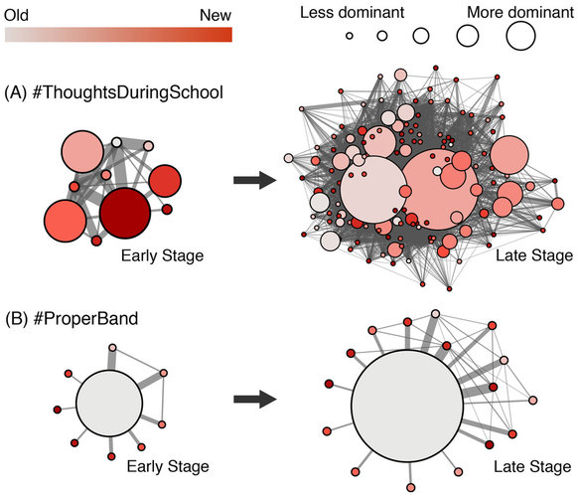
Influential early adopters are not required to produce large cascades
The evolution of a viral meme (#ThoughtsDuringSchool) from the early stage (30 tweets) to the late stage (200 tweets) of diffusion.
The evolution of a non-viral meme (#ProperBand) from the early stage to the final stage (65 tweets in total).
Effect of superstars is often exaggerated on online platforms;)
Weng, Menczer, Ahn. “Virality prediction and community structure in social networks,” Scientific Reports, 2013
Notes:
We need to consider many factors, such as…
A first hypothesis is that users who are influential/central are the most predictive of virality.

Slide 27
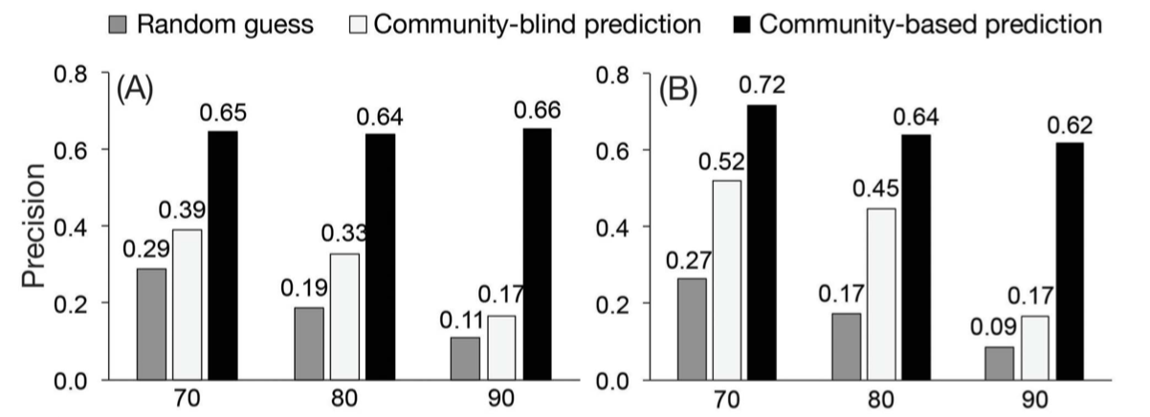
Community structure matters
Basic network features:
Number of early adopters
Number of uninfected neighbors of early adopters
Community features (structural):
Number of infected communities
Entropy of initial posts (measure the strength of concentration)
Fraction of intra-community user interactions
Read this paper (helpful for HW2):
Weng et al. “Virality prediction and community structure in social networks,” Scientific Reports, 2013
Notes:
We need to consider many factors, such as…
A first hypothesis is that users who are influential/central are the most predictive of virality.

Slide 28
Complex contagion & Cascade
Large cascades don’t depend on highly influential individuals.
Instead, they require a critical mass (no matter who) of easily influenced people connected to other easy-to-influence people.
The key to the spread of complex contagion is to find tightly connected groups of easily influenced adopters where social influence/reinforcement can flow effectively and efficiently.
Community structure can provide enough social influence needed to trigger a global cascade from the early adopters.
Can social influence exist without a network?
Are there examples of cascades without a network?
Notes:
Social influence can exist without a network. E.g. in jaywalking.
As long as social influence can kick in, the magic would still work.

Slide 29

Social Influence w/o network
Does social inﬂuence affect group decision-making processes, such as online event scheduling (Doodle)?
If so, who has a larger inﬂuence on the outcome of a poll: early respondents vs. late respondents?
Notes:
Low vs. high availability

Slide 30
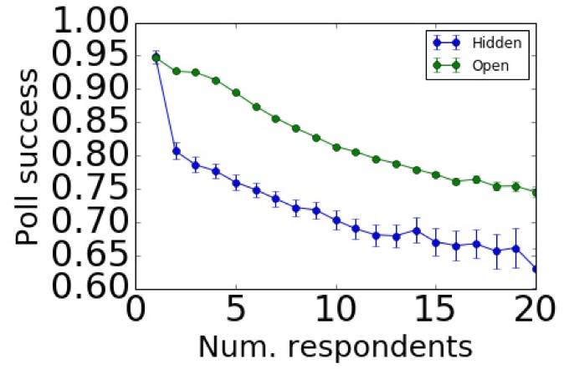
Social Influence w/o network
Open polls have a higher success rate of scheduling than hidden polls. Why is this?
But is social influence always good in this context?
Notes:
scheduling polls that allow respondents to see others’ answers are more likely to succeed than polls that hide other responses, suggesting the impact of social inﬂuence, in which later respondents adopt the decisions of earlier respondents.

Slide 31
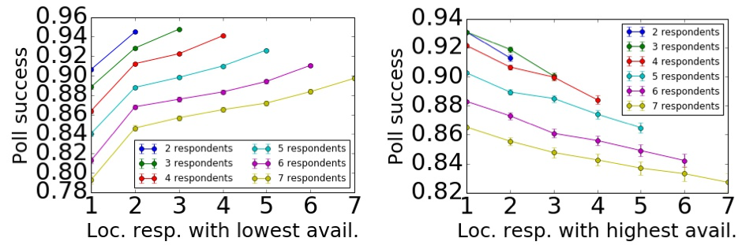
Influence: double-edged sword
The availability (behavior) of early respondents has a bigger impact on success than late ones.
Influence is beneficial if early people show high availability; but can be bad if they show low avail.
What strategy can further boost success rate?
Notes:
We identify when the respondent with the lowest/highest availability came in the sequence of respondents.
These ﬁrst two measures capture the location of the extreme respondents.
When early people are available, most people ”become” available.
When early people are unavailable, most people ”become” unavailable.

Slide 32
Mitigation strategy
Hiding early respondents vs. hiding low avail. ones?
Using agent-based modeling (ABM):
  Agent decision: α * prev. k users’ + (1-α) * her own decision
  Strategy 1: Hide the ﬁrst E users’ decision
  Strategy 2: Hide users whose availability < τ
Strategy 2 is better: one can eliminate negative effect of social inﬂuence by hiding low availability responses from just <5% of all respondents.
Extra finding: one can optimize success rate through the positive effect of social inﬂuence by hiding ~35%-65% of low availability responses.
Romero et al. “Inﬂuence of Early Respondents: Information Cascade Effects in Online Event Scheduling.” WSDM, 2017
Notes:
Determine threshold of low availability by cutting off at 5%.
Don’t need to hide all low avail. ones, just a small fraction of them.

Slide 33
Course notes
HW2 will be released this week
  Due in two weeks
Network visualization next week
Tutorial 5: Link prediction (in practice)

Slide 34

LOQ course evaluation survey
Appreciate your insightful feedback!
LOQ system: https://onlinesurvey.cityu.edu.hk/
Also available on Canvas course site.
Notes:
Important nodes identified by PR are quite different from that identified by DC.

